Slide 1
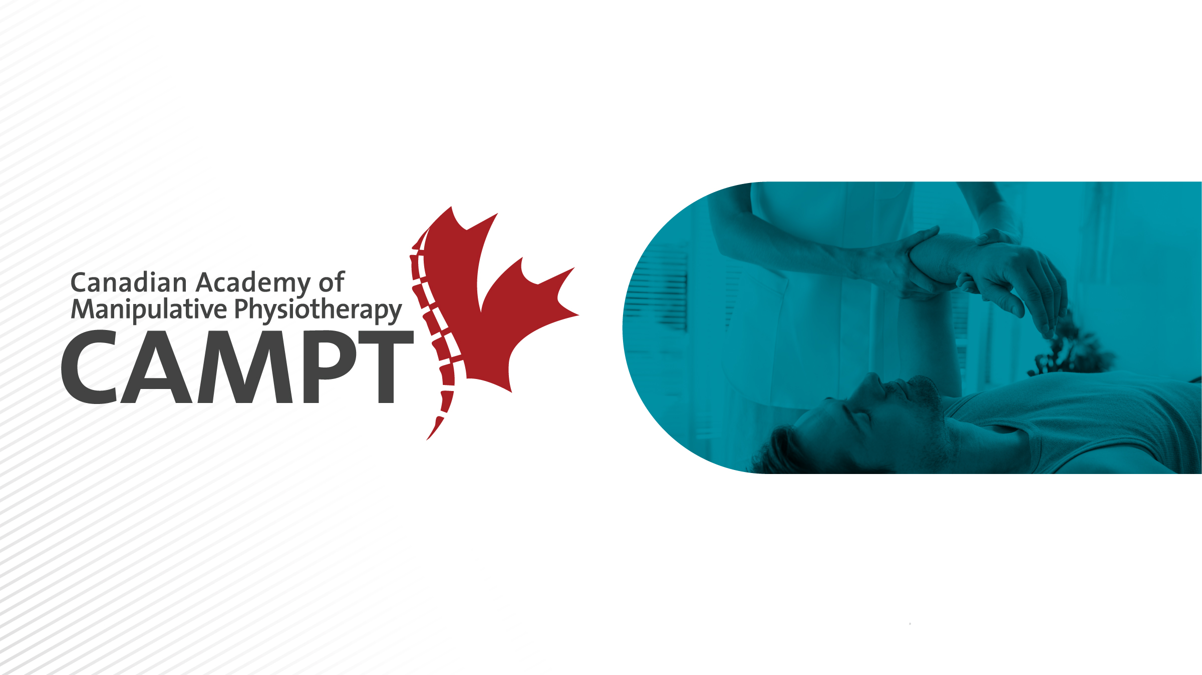
CAMPT-Certified:
The Standard for Exceptional Care

Slide 2
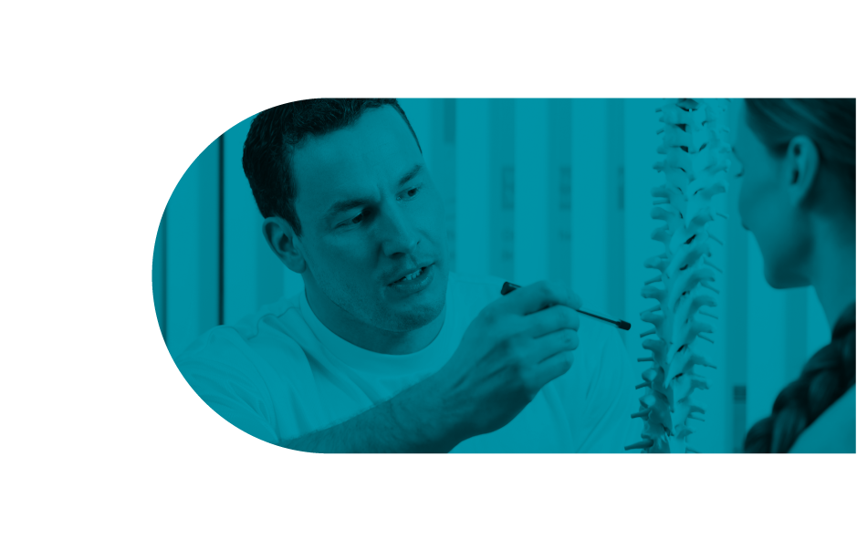

Addressing the Needs of Today’s Doctors
Practice is getting harder, the demands of the average patient are increasing, a doctor’s time is being stretched thinner than ever before, and lets face it, Dr. Google isn’t helping…
No, we can’t change the demands of the healthcare system, but we can change the load on our doctors. Let us show you how…
Eg. “The aging population - one in four Canadians will be 65 or older by 2056, compared to 13 per cent now - will put huge strains on the health care system…
The CMA estimates it would take 26,000 more doctors, right now, to bring Canada up to the OECD average. Medical schools aren't graduating enough students to keep up with demand…”
Canadian Medical Association Journal

Slide 3

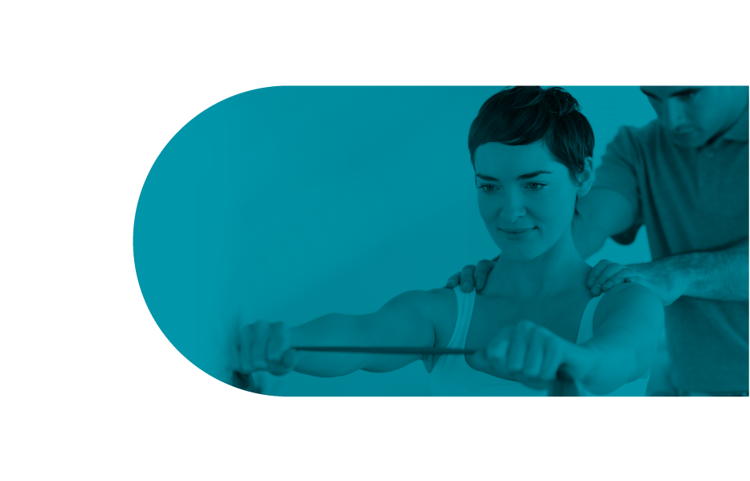
What is CAMPT?
CAMPT stands for the Canadian Academy of Manipulative Physiotherapy. CAMPT is the professional organization for physiotherapists who have completed post-graduate training in complex clinical reasoning and hands on therapy treatment techniques.
By delivering research-guided physiotherapy care, our patients:
  Get Better using techniques that meet international standards.
  Recover Faster since we find and target the root cause
  with focused treatments.
  Stay Healthier by educating them about their condition
  to reduce relapse.
Notes:
Canadian Academy of Manipulative Physiotherapy (CAMPT) is a professional group of physiotherapists who have completed post-graduate training in hands on therapy treatment techniques, joint manipulation, and clinical reasoning skill. Research has shown that CAMPT-trained physiotherapists have successful treatment outcomes with their patients.

Slide 4
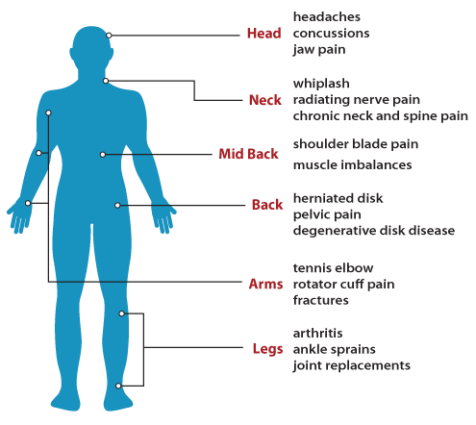
How Does an FCAMPT Help My Patients?
Research-guided techniques used by Fellows of CAMPT (FCAMPTs) aims to improve pain control, functional activities, and a patient’s health independence. This means:
  Less follow up visits needed
  Less reoccurrence and chronicity
  Less administration!!
  Less dependency on medication
“Following manipulative therapy treatment for neurogenic cervicobrachial pain, visual analysis revealed beneficial effects on pain, functional disability, as well as cervical and shoulder mobility. These improvements were maintained over the home exercise phase and at 1-month follow-up.”
Cowell IM I, Phillips CR., 2002.

Slide 5
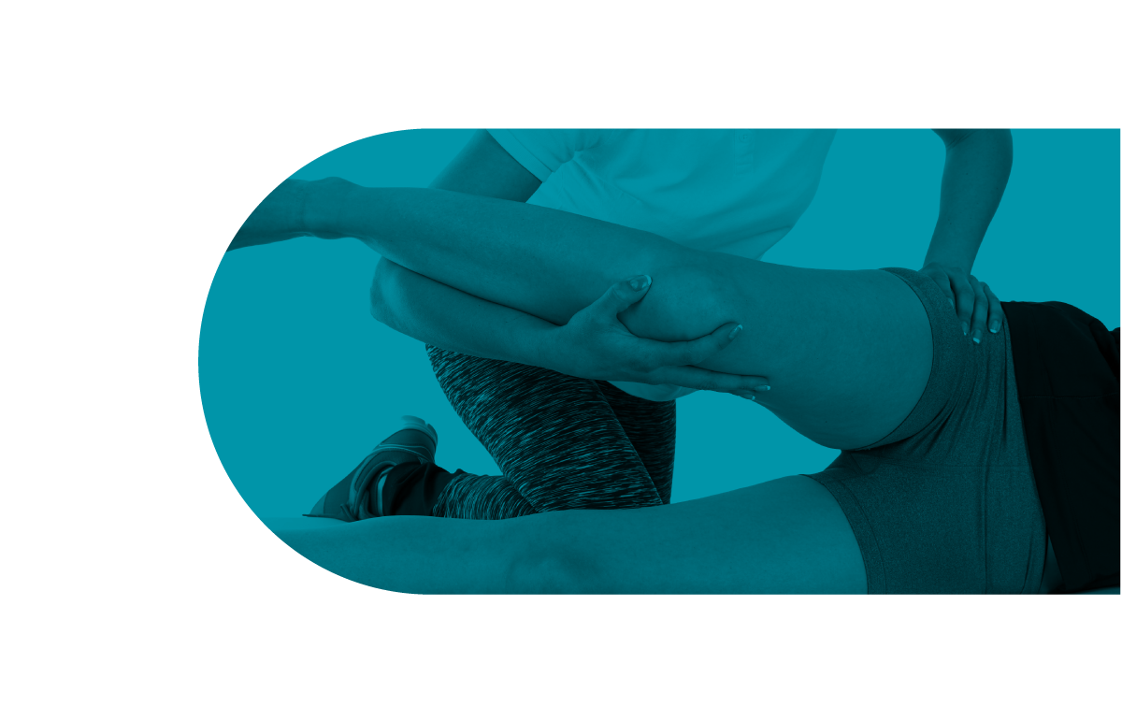
Effectiveness
An FCAMPTs success comes from their clinical reasoning and diverse treatment options – including Manual and Manipulation therapy which has been supported as a safe and effective form of treatment.
  Treatment with manual therapy and exercise shows greater pain reduction up to 40% in 6 weeks in patients with an acute whiplash compared to less than 5% recovery with educational videos and self care (Miller et al. 2010)
  Mobilization and manipulation are effective treatment options
  for mechanical neck pain (Gross et al. 2007, Jull et al. 2002)
  Manual Therapy and exercise has been shown to improve
  symptoms post ankle sprain more so than exercise alone
  (Lubbe et al. 2015)
  Manipulation was found to be more effective than
  mobilization or exercise in the treatment of acute lower
  back pain (Clealand et al., 2009)
Notes:
One of the main treatment tools used by FCAMPTs is hands on mobilization and manipulation techniques. There is a growing body of evidence to support these techniques.
Following a Whiplash associated disorder, Treatment with manual therapy and exercise shows greater pain reduction up to 40% in just 6 weeks, while recovery was less than 5% recovery using educational videos and self treatment techniques.
There is a growing body of evidence to support manual and manipulative therapy to both the cervical and thoracic spine as effective treatment options for chronic neck pain
Ankle sprains have been studies to show up to 72% of people have persistent symptoms 6 months following injury. Treatment consisting of manual therapy and exercises demonstrated improved pain and symptoms in acute ankle sprains compared to exercise alone.
And specifically for manipulative therapy, Cleland et al found that manipulation was more effective for treating acute, mechanical low back pain than exercise or manual therapy.

Slide 6

How Does an FCAMPT Help My Practice?
Sharing the workload: FCAMPTs are a reliable partner in orthopeadic diagnosis
  FCAMPTs will properly recommend further medical interventions required
  FCAMPTs are trained to identify which medical investigations are appropriate for the orthopeadic presentations they see
More time per patient for you
  Time to help a greater number of people
  Less potential for professional burnout
Improved patient satisfaction
  When successful treatment and referrals prescribed
Let FCAMPTs be the difference in your practice

Slide 7
Why Have I Not Heard Of CAMPT Before?
More recognized internationally than in our own backyard
  But 800 FCAMPTs in Canada and growing
Advertising Limitations by the Colleges of Physiotherapy
  … We would say more… but we can’t ☺
  However, times are changing…
Launched a marketing initiative to raise our profile
  Presentations such as this with healthcare professionals
  Education for our members on how to leverage our brand
  Campaign to the public through social media and
  our new website

Slide 8
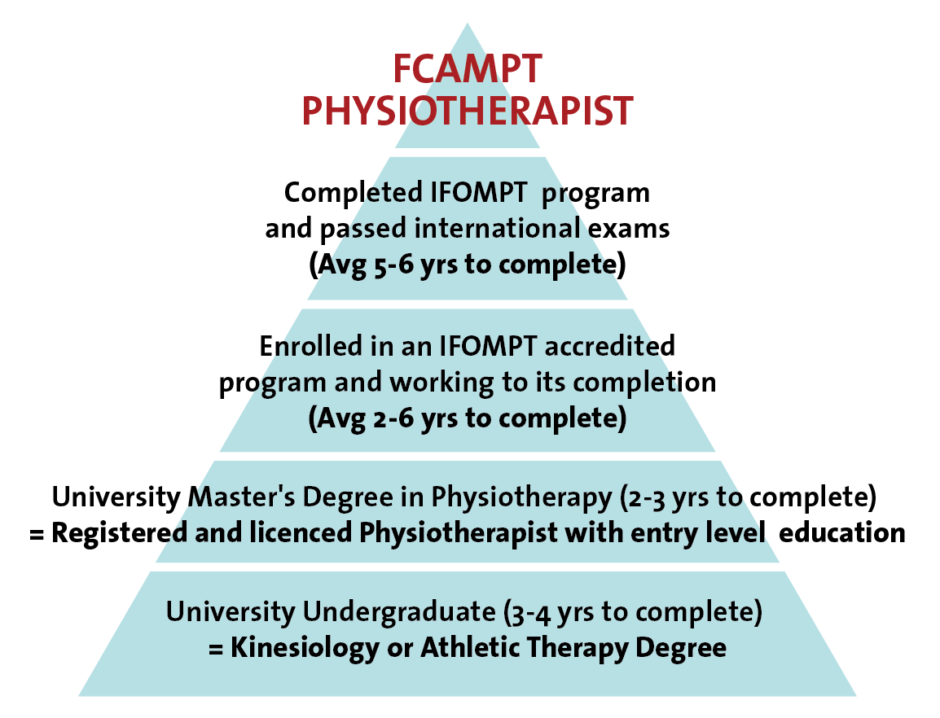
So What Makes an FCAMPT Different?
Education and Experience is the Difference
CAMPT-Certified physiotherapists earn their FCAMPT designation by:
  Completing an IFOMPT internationally accredited physiotherapy education program
  The IFOMPT education goes Beyond the core university education required to become a physiotherapist in Canada

Slide 9


CAMPT Upholds an International Standard
CAMPT is Canada’s member organization of the International Federation of Orthopaedic Manipulative Physiotherapy (IFOMPT).
IFOMPT is a subsection of the WHO with the mandate to develop and monitor a standardized, high-level of orthopaedic manual physical therapy world wide.
The World Confederation for Physical Therapy (WCPT) is
the sole international voice for physical therapy.
Notes:
Canada is a member organization of IFOMPT – The International Federation of Orthopeadic Manipulative Physical Therapists. IFOMPT has high educational accreditation standards for the countries that wish to obtain membership. These standards are regularly assessed and monitored by a third party to ensure they are upheld. Canada’s membership organization of IFOMPT is CAMPT – the Canadian Academy of Manipulative Physiotherapists. There are currently two educational insinuations in Canada that are being monitored for quality assurance by CAMPT. Any graduates from these programs can apply for Fellowship of CAMPT and may use the trademarked and protected FCAMPT title.

Slide 10
Why Choose FCAMPT Physiotherapists
FCAMPTs provide focused treatment based on research-guided techniques that speed up patient recovery while educating them about their condition to reduce the risk of relapse.
  FCAMPT is an internationally recognized standard
  Additional training in assessment and clinical reasoning
  Expertise in manual therapy
“FCAMPT trained physiotherapists demonstrated
functional status changes and efficiency greater
than those who were residency trained or had
no fellowship or residency training.”
Rodeghero et al, 2015
Notes:
Hopefully you said physiotherapy or maybe more specifically a musculo-skeletal physiotherapists. And that’s a great answer. When we graduate as Physiotherapists, we graduate as generalists. That is we have Basic assessment and treatment skills in the areas of orthopeadic, neurological and cardiovascular rehab. And we have met National entry-level education and practice standard. However, we are here today to discuss with you what is an FCAMPT physiotherapists and why you would want to choose an FCAMPT physiotherapist.

Slide 11

Referring Your Patients
Make a CAMPT-Certified physiotherapist part of your medical team.
Protected and monitored accreditation:
  Valid seals automatically go to CAMPT website to review profile.
  Physical seal and certificate also present at the therapist’s office.
Find an FCAMPT:
manippt.org/find-a-campt-certified-physiotherapist/

Slide 12
Questions?

Slide 13
References
Canadian Physiotherapy Association. Description of Physiotherapy in Canada. 2012. http://www.physiotherapy.ca/
Canadian Academy of Manipulative physical Therapists. http://manippt.org/
Gross A, Goldsmith C, Hoving JL, et al. Conservative management of mechanical neck disorders: a systematic review. J Rheumatol. 2007;34(5):1083-1102
Jull G, Trott P, Potter H, et al. A randomized control trial of exercise and manipulative therapy for cervicogenic headache. Spine. 2002;27(17):1835-1843.
Cleland JA, Fritz JM, Kulig K, Davenport TE, Eberhart S, Magel J, Childs JD. Comparison of the effectiveness of three manual physical therapy techniques in a subgroup of patients with low back pain who satisfy a clinical prediction rule: a randomized clinical trial. Spine (Phila Pa 1976). 2009 Dec 1;34(25):2720-9.

Slide 14
References
Haines T, Gross AR, Burnie S, Goldsmith CH, Perry L, Graham N; Cervical Overview Group (COG). A Cochrane review of patient education for neck pain. Spine J. 2009 Oct;9(10):859-71
Lubbe D, Lakhani E, Brantingham JW, Parkin-Smith GF, Cassa TK, Globe GA, Korporaal C. Manipulative therapy and rehabilitation for recurrent ankle sprain with functional instability: a short-term, assessor-blind, parallel-group randomized trial. J Manipulative Physiol Ther. 2015 Jan;38(1):22-34.
Miller J1, Gross A, D'Sylva J, Burnie SJ, Goldsmith CH, Graham N, Haines T, Brønfort G, Hoving JL. Manual therapy and exercise for neck pain: A systematic review. Man Ther. 2010 Jun 1.
Rodeghero J, Wang Y, Flynn T, Cleland J, Wainner R, Whitman J. The Impact of Physical Therapy Residency or Fellowship Education on Clinical Outcomes for Patients With Musculoskeletal Conditions. J Orthop Sports Phys Ther. 2015;45(2):86-96.
Cowell IM I, Phillips CR., In Manual Therapy. Effectiveness of manipulative physiotherapy for the treatment of a neurogenic cerviccbrachial pain syndrome: a single case study — experimental design. 2002 Feb;7(l):31-8.

