Slide 1
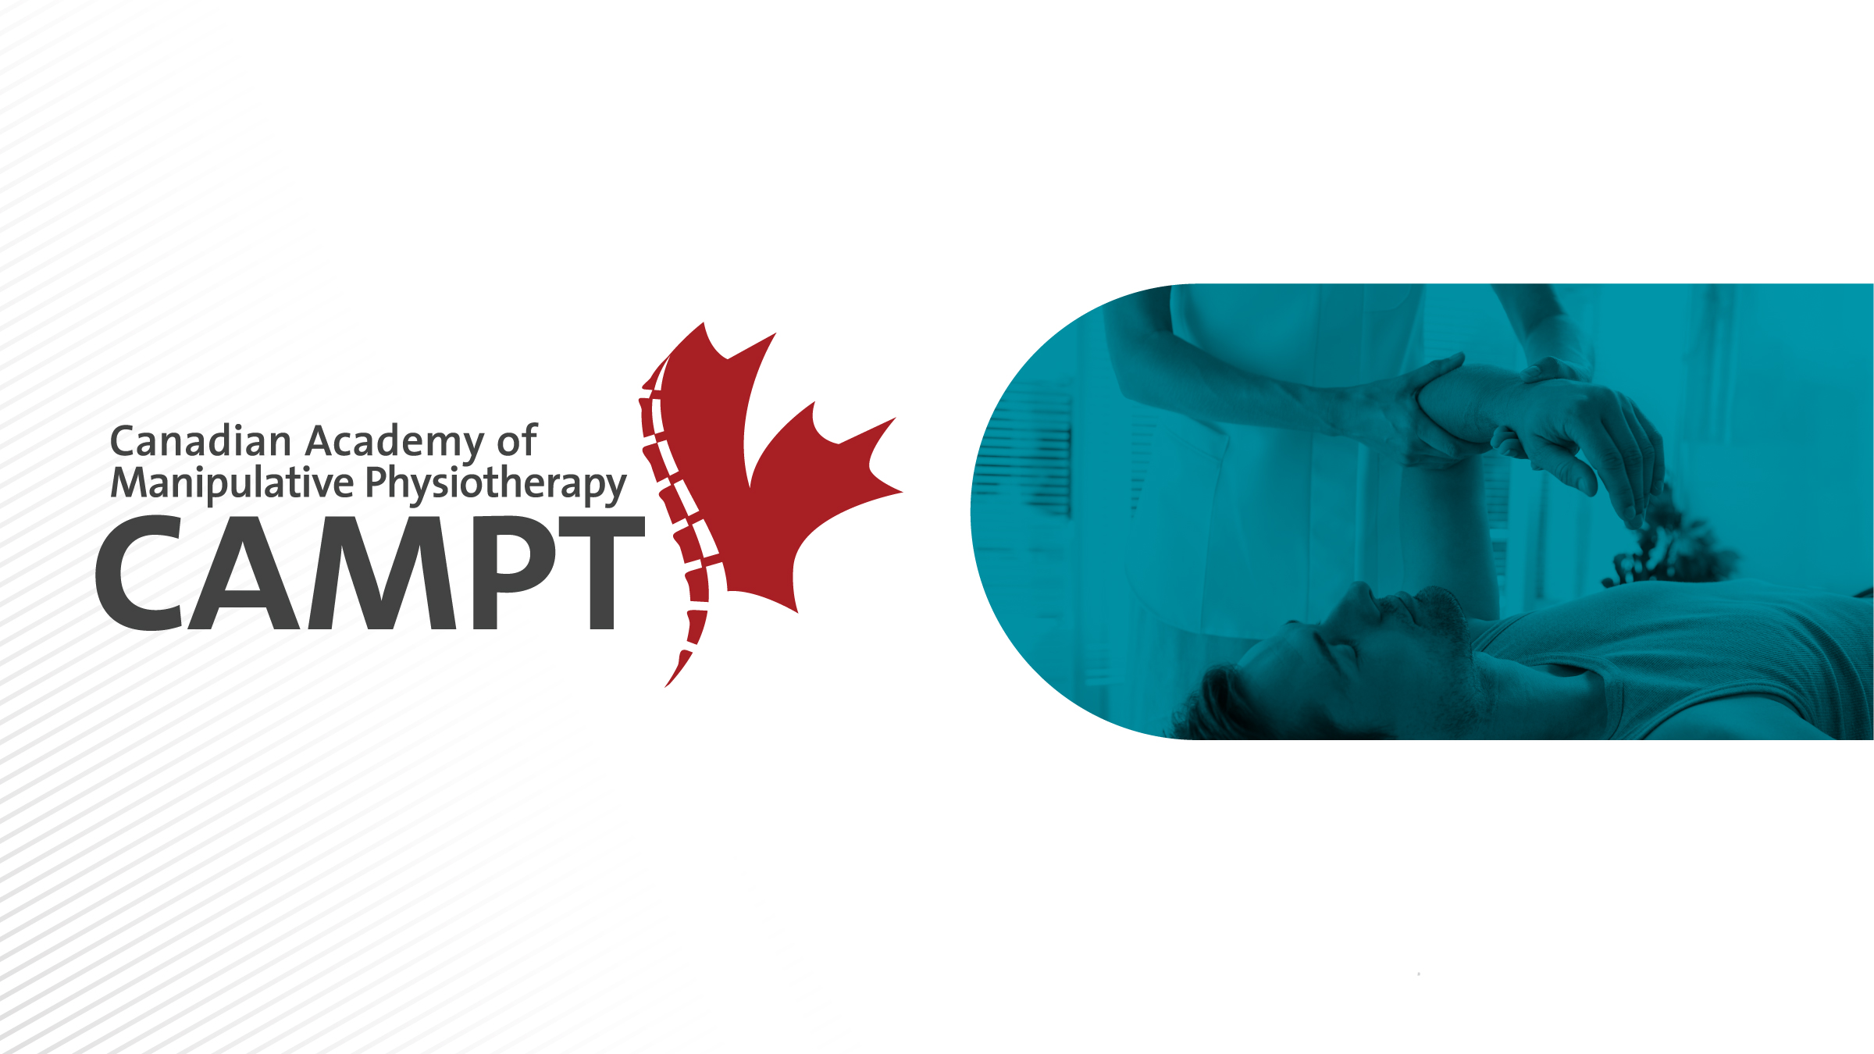
CAMPT-Certified:
The Standard for Exceptional Care

Slide 2

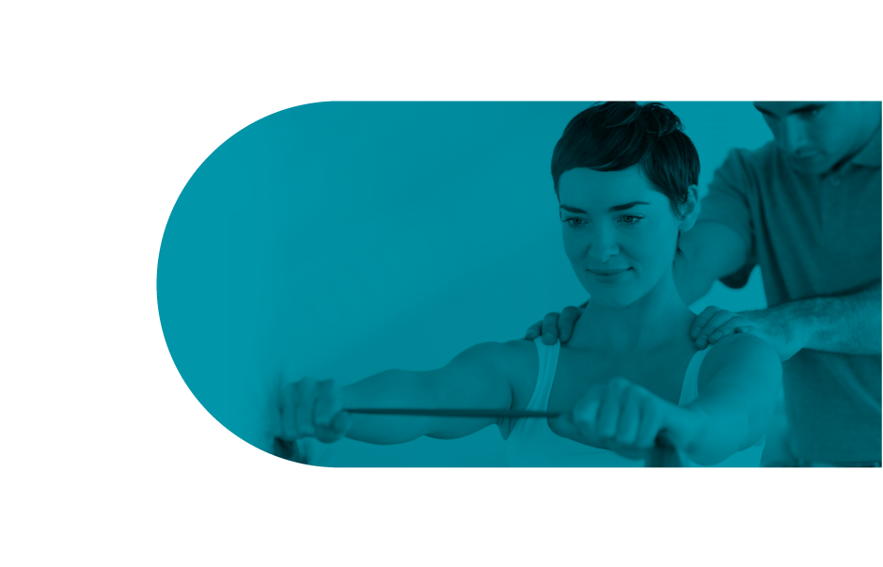
What is CAMPT?
Canadian Academy of Manipulative Physiotherapy (CAMPT) is the professional organization for physiotherapists who have completed post-graduate training in hands on therapy treatment techniques.
By delivering research-guided physiotherapy care, our patients:
  Get Better using techniques that meet international standards
  Recover Faster since we find and target the root cause
  with focused treatments
  Stay Healthier by educating them about their condition
  to reduce relapse.
Notes:
Canadian Academy of Manipulative Physiotherapy (CAMPT) is a professional group of physiotherapists who have completed post-graduate training in hands on therapy treatment techniques, joint manipulation, and clinical reasoning skill. Research has shown that CAMPT-trained physiotherapists have successful treatment outcomes with their patients.

Slide 3
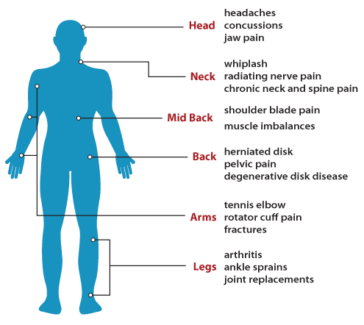
How can FCAMPTs Help
CAMPT-Certified physiotherapists are Fellows of the Canadian Academy of Manipulative Physiotherapy (FCAMPT).
Research-guided techniques
used by FCAMPTs are aimed at improvements to pain control and functional activities.

Slide 4
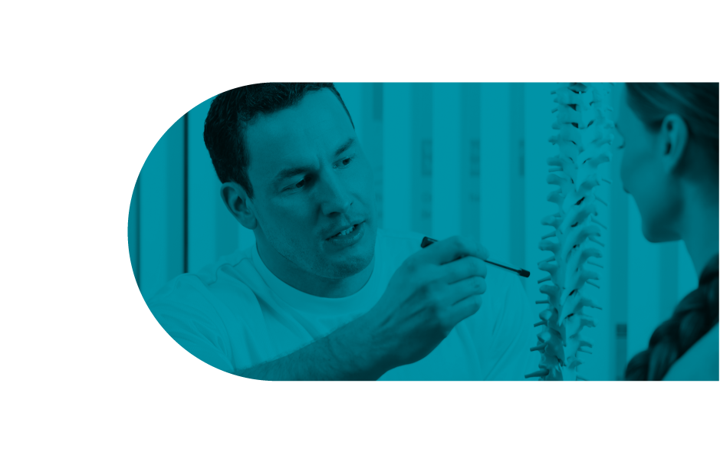
Why Choose FCAMPT Physiotherapists
FCAMPTs provide focused treatment based on research-guided techniques that speed up patient recovery while educating them about their condition to reduce the risk of relapse.
  FCAMPT is an internationally recognized standard
  Additional training in assessment and clinical reasoning
  Expertise in manual therapy

Slide 5


Internationally Recognized Standard
CAMPT is Canada’s member organization of the International Federation of Orthopaedic Manipulative Physiotherapy (IFOMPT).
IFOMPT is a subsection of the WHO with the mandate to develop and monitor a standardized, high-level of orthopaedic manual physical therapy world wide.
The World Confederation for Physical Therapy (WCPT) is
the sole international voice for physical therapy.
Notes:
CAMPT is the Canadian member organization of the International Federation of Orthopaedic Manipulative Physiotherapy (IFOMPT), a part of the World Confederation of Physiotherapy and the World Health Organization. IFOMPT’s mandate is to ensure a high standard of Orthopaedic Physiotherapy that is consistent around the world. CAMPT monitors Canadian programs and sends reports to IFOMPT. If you complete education from any of CAMPT’s 3 monitored institutions you can apply to become a Fellow of CAMPT or FCAMPT. This means the FCAMPT is an internationally recognized title.

Slide 6
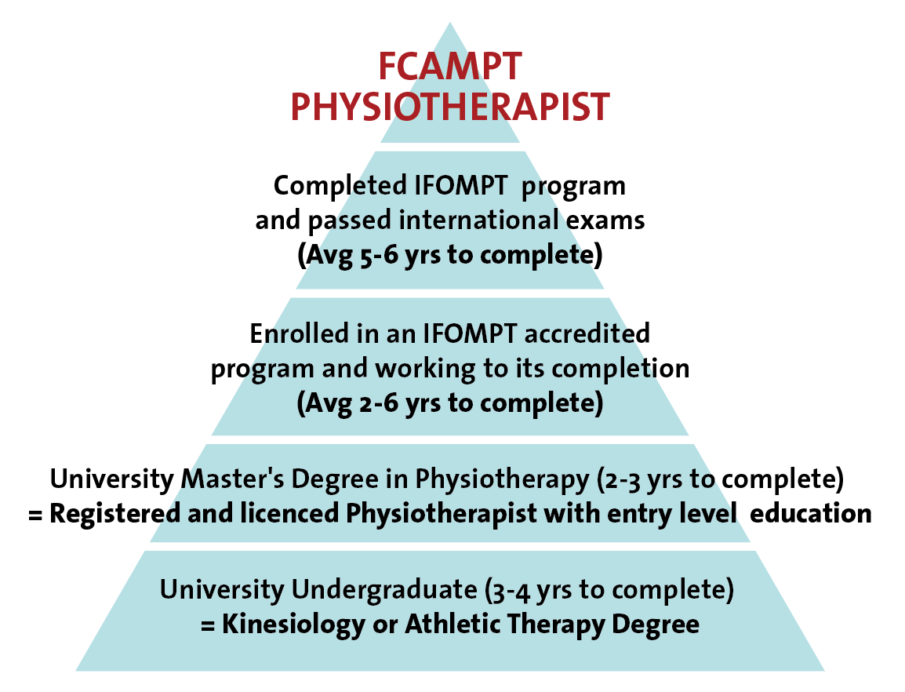
Additional Training
CAMPT-Certified physiotherapists earn their FCAMPT designation by:
  Completing an IFOMPT internationally accredited physiotherapy education program
  Beyond the core university education required to become a physiotherapist in Canada

Slide 7



IFOMPT-accredited Programs
Three programs in Canada are recognized and accredited by the International Federation of Orthopaedic Manipulative Physiotherapists (IFOMPT).
CAMPT monitors these programs to ensure they meet the standards of IFOMPT.
Notes:
Currently, these are the three programs recognized and monitored by CAMPT. One is through the community based level system of the Canadian Physiotherapy Association’s Orthopeadic Division. The other two are through Western University or McMaster University They teach advanced practice in manual therapy, manipulative therapy, clinical reasoning, orthopeadic rehabilitation, and evidence based medicine. The content of these programs is monitored and approved by the IFOMPT standards committee and held to international standards. These acquired skills provide FCAMPTs exceptional reasoning and experience for tough clinical cases.

Slide 8
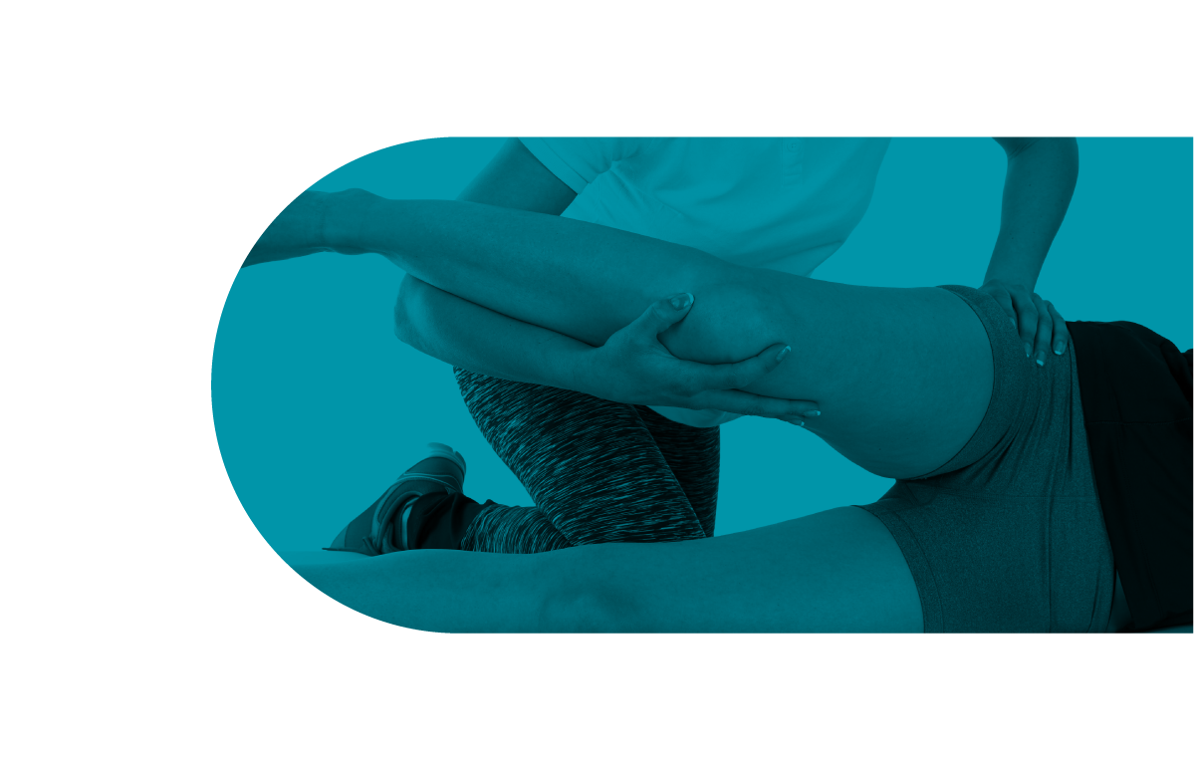
Expertise in Manual Therapy
Manual and manipulative therapy is a safe and effective form of treatment.
  Skilled hands-on treatments applied by highly qualified physiotherapists.
  Techniques such as thrust manipulation have demonstrable benefits for reducing muscle pain and tension, and for restoring normal joint movement.
Research demonstrates that manipulative therapy can
help you return faster to pain-free living.
Notes:
Treatment with manual therapy and exercise shows greater pain reduction up to 40% in 6 weeks in patients with an acute whiplash compared to less than 5% recovery with educational videos and self care (Miller et al. 2010)
Mobilization and manipulation are effective treatment options for mechanical neck pain (Gross et al. 2007, Jull et al. 2002)
Manual Therapy and exercise has been show to improve symptoms post ankle sprain more so than exercise alone (Lubbe et al. 2015)
Manipulation was found to be more effective than mobilization or exercise in the treatment of acute lower back pain (Clealand et al., 2009)

Slide 9

Look for the CAMPT-Certified logo
FCAMPTS display this logo on their website, business cards and in their offices
Protected and monitored accreditation:
  Valid seals automatically go to CAMPT website to review profile.
  Physical seal and certificate also present at the therapist’s office.
Find an FCAMPT:
manippt.org/find-a-campt-certified-physiotherapist/

Slide 10
Questions?

