Slide 1
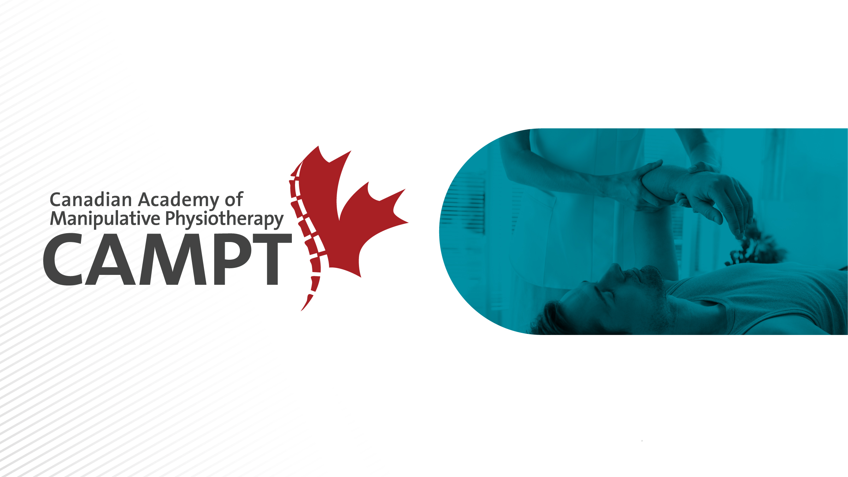
Become an FCAMPT:
The Standard for Exceptional Care

Slide 2

What is CAMPT?
Canadian Academy of Manipulative Physiotherapy (CAMPT) is a professional organization of physiotherapists who have completed post-graduate training in hands on therapy treatment techniques
By delivering research-guided physiotherapy care, our patients:
  Get Better using techniques that meet international standards
  Recover Faster since we find and target the root cause
  with focused treatments
  Stay Healthier by educating them about their condition
  to reduce relapse.
Notes:
Canadian Academy of Manipulative Physiotherapy (CAMPT) is a professional group of physiotherapists who have completed post-graduate training in hands on therapy treatment techniques, joint manipulation, and clinical reasoning skill. Research has shown that CAMPT-trained physiotherapists have successful treatment outcomes with their patients.

Slide 3


CAMPT Affiliations
CAMPT is Canada’s member organization of the International Federation of Orthopaedic Manipulative Physiotherapy (IFOMPT)
IFOMPT is a subsection of the WHO to monitor and encourage a high level of standardization among orthopeadic physiotherapy worldwide
The World Confederation for Physical Therapy (WCPT) is
the sole international voice for physical therapy
Notes:
CAMPT is the Canadian member organization of the International Federation of Orthopaedic Manipulative Physiotherapy (IFOMPT), a part of the World Confederation of Physiotherapy and the World Health Organization. IFOMPT’s mandate is to ensure a high standard of Orthopaedic Physiotherapy that is consistent around the world. CAMPT monitors Canadian programs and sends reports to IFOMPT. If you complete education from any of CAMPT’s 3 monitored institutions you can apply to become a Fellow of CAMPT or FCAMPT. This means the FCAMPT is an internationally recognized title.

Slide 4
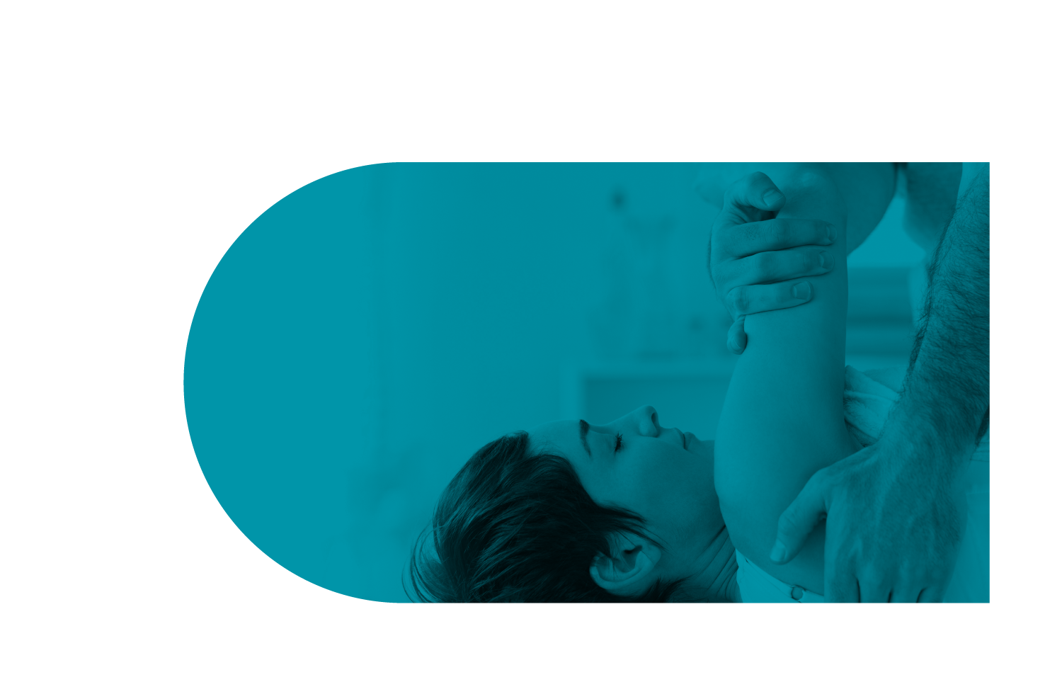
Benefits of being FCAMPT
Membership gives you the right to use the designation Fellow of the Canadian Academy of Manipulative Physiotherapy (FCAMPT)
  FCAMPT is a trademarked and protected title
CAMPT-Certified program is designed to raise awareness of the FCAMPT title.
Key elements of this program include:
  CAMPT-Certified Get Started kit
  CAMPT website and social media
  Training and support
  Outreach
Notes:
Because of these standards, FCAMPT is a trademarked and protected title which is enforced by CAMPT to only be used by register FCAMPTs. When you are FCAMPT you have access to the CAMPT-Certified program.

Slide 5
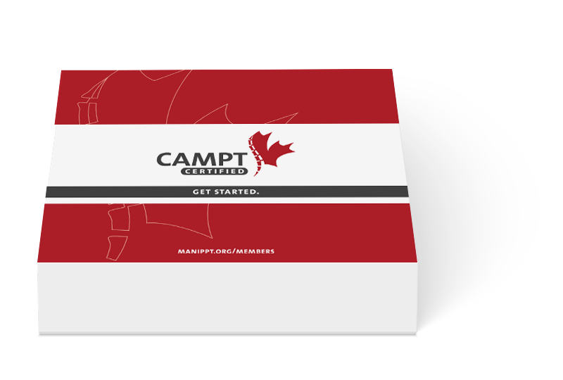
CAMPT-Certified Get Started Kit
Members receive our CAMPT-Certified package that includes:
  Professional embossed seal with personalized registration number
  8GB USB key with new logos and printable forms in French and English
  Get Started instructional guide
  Sample manipulation information pamphlet for patients
  Sample FCAMPT educational handout for patients with place
  to staple business cards
  Double-sided window or wall CAMPT-Certified sticker
Download a digital version of your seal and the material
above in the members area of the CAMPT website
Notes:
As part of the CAMPT-Certified program you will receive a mandatory promotional Get Started kit that contains tools to help promote yourself, education your patients on your new FCAMPT qualifications, and join a country- wide brand recognition and awareness campaign. You can leverage CAMPT’s ongoing efforts to continue to promote what FCAMPT states means to patients, doctors, insurance companies, and our provincial colleges.

Slide 6




CAMPT Website and Social Media
The CAMPT website explains the benefits of FCAMPT certification to patients, practioners, and students
  Search function on the home page enables patients and practioners to find local CAMPT-Certified physiotherapists
CAMPT is also building an active presence on Facebook, Twitter and LinkedIn to build awareness of CAMPT.
Notes:
CAMPT has developed a new website, is upgrading their find a therapist search engine, and continually using social media efforts to promote FCAMPT qualifications via an active presence on Facebook, Twitter, YouTube and LinkedIn.

Slide 7
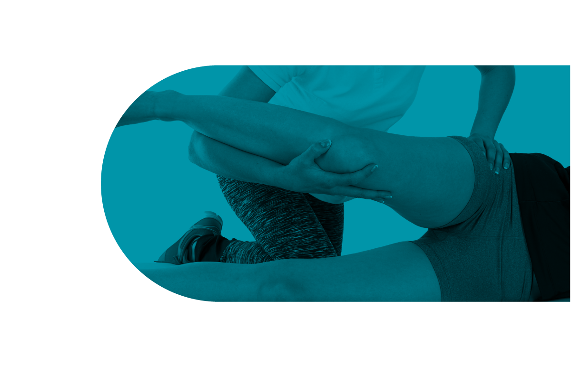
Training and Support
Continued professional development
  Discounted rates to CAMPT sponsored manipulative physiotherapy refresher courses across Canada
  Discounted rates to Ortho Div partnered Ortho Symposium
Networking and marketing opportunities with
other members exist at various events.
Voting rights for CAMPT initiatives

Slide 8
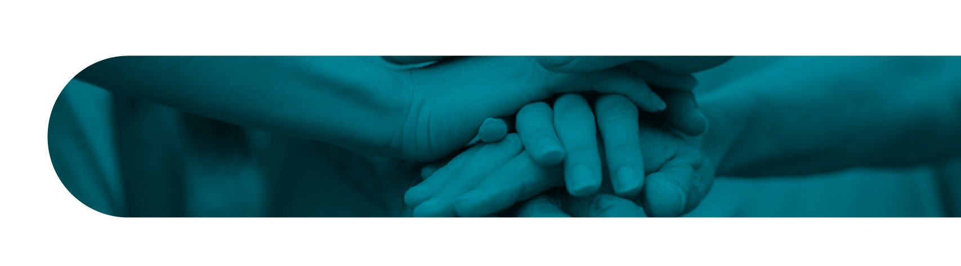
Outreach
Supports international initiatives that promote manual therapy curriculum in developing countries
Provides research funding assistance to Canadian and internationally-driven projects annually
FCAMPTs have opportunities to become a mentor or instructor as part of the certification processes

Slide 9
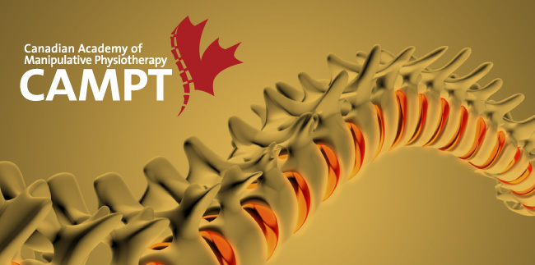
Ongoing CAMPT Marketing Initiatives
Plans to promote FCAMPT qualifications to the public, physicians and insurance companies to make CAMPT-Certified a recognized brand
  Ongoing web and social media efforts
  Marketing plan under development
Start by encouraging adoption of
CAMPT-Certified brand by FCAMPTs
  How to leverage the CAMPT brand email series
  Conduct survey for feedback on the program
Notes:
This marketing program is an ongoing project with the next steps to promote FCAMPT qualifications to the public, physicians, and insurance companies. CAMPT’s goal is to become a ‘household’ name.
FCAMPT’s across the country are now using the same message to promote themselves as one unified body.

Slide 10


Global Links
Global representation
  Transferable qualifications
  International initiatives
  Reciprocity in select IFOMPT countries
Notes:
There are other counties with the same qualifications around the world that are recognized under a similar title. If you decide to move to one of those counties and practice your qualifications are easily transferable to their equivalent title with CAMPT’s reciprocal recognition program for other IFOMPT accredited counties.

Slide 11
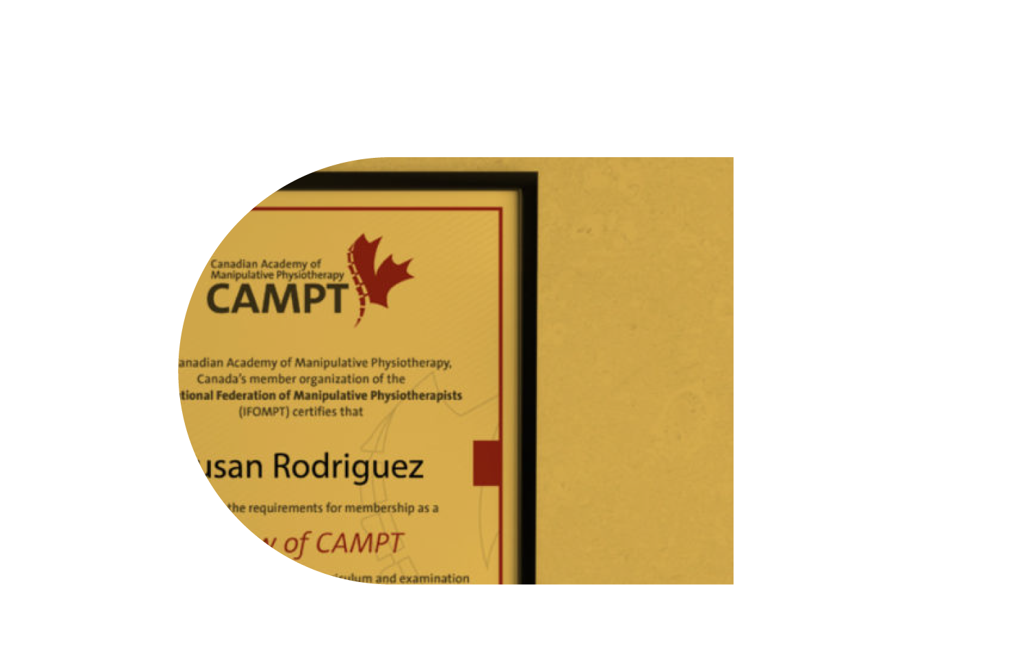
Becoming a FCAMPT
Requirements for becoming FCAMPT:
    Licensed physiotherapist
    Successful completion of an IFOMPT accredited program
    Current membership with the Canadian Physiotherapy Association
    Current membership with the Orthopaedic Division of the
    Canadian Physiotherapy Association
Canada offers three IFOMPT accredited programs
    CPA Orthopaedic Division ▪ Level System
    WesternUniversity▪ Masters of Clinical Science
    McMaster University ▪ Masters of Science (Rehabilitation Science)

Slide 12
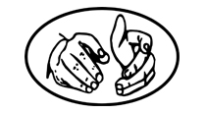
Diploma of Advanced Orthopaedic
Manual and Manipulative Physiotherapy
Level 1 Course/Challenge Exam
(Written exam and case history)
90 Hours clinical mentorship
Level 2 Upper Course
(Written exam and case history)
Level 2 Lower Course
(Written exam and case history)
Level 3 Upper Course
(Written exam and case history)
Level 3 Lower Course
(Written exam and case history)
Intermediate Practical Exam
60 Hours clinical mentorship
Level 4 Course
Level 5 Course
Advanced Exams
(Case history, multiple choice, practical exams)
Notes:
5 levels of community-based coursework and examination, available regionally across the country
Courses include theory in advanced orthopedics, manual skills, clinical reasoning, and case based learning opportunities
Manuals and course objectives uniform across Canada
Written and OSCE examinations (written, case and practical)

Slide 13

Masters of Clinical Science
(Manipulative Therapy)
Admission into MClSc Program
September residency 3.5 weeks
40 Hours clinical mentorship
On-line distance learning / Courses
February residency 3 weeks
(Practical, multiple choice, case history exam)
45 Hours clinical mentorship
On-line distance learning / Courses
July residency 2 weeks
(Practical, case history exam)
(Research project poster presentation)
Notes:
One year, distance learning, university-based program. With three on campus residency periods throughout the year.
Includes courses in advanced orthopedics and manipulative therapy, research methodology, a research project, professionalism, and clinical reasoning
Written and OSCE examinations (written, case and practical)
Admission requirements :
Entry level Physiotherapy degree and at least a (B) standing over the final two years of the program
A current license to practice in Canada
Level II Upper and Lower courses in the CPA Orthopaedic Division
30 hours of documented mentoring
Two years of full-time experience in orthopaedic physical therapy

Slide 14


Masters of Science (Rehabilitation Science)
Area of Specialization: Orthopaedic Manipulative Physical Therapy (OMPT)
Admission into 2-3 year Program (start Sept or Jan)
▪ Three (3) Foundation Courses (on-line, 3 units each):
▪ REHAB705 Evaluating Sources of Evidence
▪ REHAB706 Measurement in Rehabilitation
▪ REHAB708 Clinical Reasoning and Decision-Making
▪ Two (2) OMPT Courses (on-line & on-site, 3 units each):
▪ REHAB715 Advanced Orthopaedic Manipulative Physiotherapy
(Lab ▪ 14 days; Teaching Mentorship ▪ 60 hrs)
▪ REHAB703 Special Topics in Rehabilitation (Clinical Residency ▪ 90 hrs; Independent Study)
▪ One (1) Research Project (6 units)
▪ REHAB735 Rehabilitation Research Project (Independent Study)
Notes:
2 to 3 years, on-line and on-site learning, university-based program. With two on campus lab periods throughout 2nd year.
The MSc course-based option of the RS Graduate Program is offering a Clinical and Research Specialization: Orthopaedic Manipulative Physical Therapy (OMPT). The area of study in OMPT develops a specialization standard in orthopaedic manipulative physiotherapy clinical practice. The objective is to advance scientific knowledge, clinical reasoning application, and clinical and research skills development with a broad appreciation of the concepts of clinical measurement and integrated evidence-based practice in OMPT practice.
Case-reports (CARE), Oral Case-simulated Recall with experts, written quiz and OSCE examinations (written, case and practical)
Admission requirements :
The MSc course-based option, area of specialization in OMPT, in Rehabilitation Sciences is offered on a part-time basis only.
Hold a four (4) year pass or honours or graduate-entry masters or professional doctorate degree in physiotherapy.
Have completed two (2) years full-time relevant professional experience (or equivalent) with two (1) years in a specialty area.
Produce evidence of continuing professional education including Level III certificate from Canadian Physiotherapy Association (CPA) Orthopaedic Division or equivalent.
Meet admission requirements to the MSc (RS) course-based option (listed above) or permission of the Program Coordinator.

Slide 15
Take the next step…
Challenge yourself to become a better therapist everyday as you work towards becoming an FCAMPT.
  http://manippt.org/become-a-campt-member/
More information:
  CAMPT website http://manippt.org/ or on Linkedin, Twitter, Facebook
  IFOMPT website http://www.ifompt.com/
  Ortho Division Website http://orthodiv.org/
  Western University MClSc Website http://www.uwo.ca/fhs/pt/programs/mclsc/manip.html
  McMaster University MSc(RS) Website: http://srs-mcmaster.ca/rehabilitation-science/orthopoaedic-manipulative-physical-therapy-ompt

Slide 16
Visit us online at: manippt.org

